Slide 1
Mathematical building blocks of neural networks
Dr. Noman Islam

Slide 2
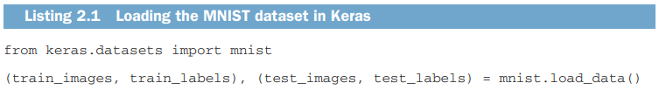
Note on classes and labels
In machine learning, a category in a classification problem is called a class.
Data points are called samples.
The class associated with a specific sample is called a label.

Slide 3
train_images.shape
The workflow will be as follows: First, we’ll feed the neural network the training data, train_images and train_labels.
The network will then learn to associate images and labels.
Finally, we’ll ask the network to produce predictions for test_images, and we’ll verify whether these predictions match the labels from test_labels.

Slide 4
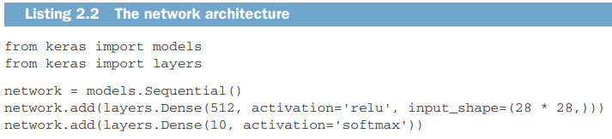

Slide 5
Layers
The core building block of neural networks is the layer, a data-processing module that you can think of as a filter for data.
Some data goes in, and it comes out in a more useful form.
Specifically, layers extract representations out of the data fed into them—hopefully, representations that are more meaningful for the problem at hand.
Most of deep learning consists of chaining together simple layers that will implement a form of progressive data distillation.
A deep-learning model is like a sieve for data processing, made of a succession of increasingly refined data filters—the layers.

Slide 6
Compiling models
A loss function—How the network will be able to measure its performance on the training data, and thus how it will be able to steer itself in the right direction.
An optimizer—The mechanism through which the network will update itself based on the data it sees and its loss function.
Metrics to monitor during training and testing—Here, we’ll only care about accuracy (the fraction of the images that were correctly classified).

Slide 7
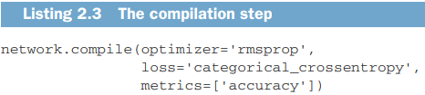
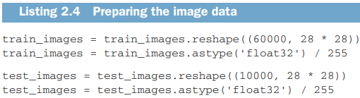

Slide 8
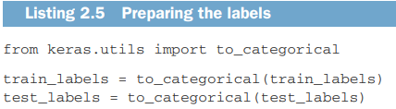
One hot encoding

Slide 9
Training and evaluating
This gap between training accuracy and test accuracy is an example of overfitting: the fact that machine-learning models tend to perform worse on new data than on their training data.

Slide 10
Data representations for neural network
In general, all current machine-learning systems use tensors as their basic data structure
Tensors are fundamental to the field—so fundamental that Google’s TensorFlow was named after them
At its core, a tensor is a container for data—almost always numerical data.
So, it’s a container for numbers.
You may be already familiar with matrices, which are 2D tensors: tensors are a generalization of matrices to an arbitrary number of dimensions (note that in the context of tensors, a dimension is often called an axis).

Slide 11
Scalars (0D tensor)
A tensor that contains only one number is called a scalar (or scalar tensor, or 0-dimensional tensor, or 0D tensor).
In Numpy, a float32 or float64 number is a scalar tensor (or scalar array).
You can display the number of axes of a Numpy tensor via the ndim attribute; a scalar tensor has 0 axes (ndim == 0).
The number of axes of a tensor is also called its rank

Slide 12
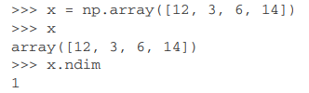
Vector (1D tensor)
An array of numbers is called a vector, or 1D tensor.
A 1D tensor is said to have exactly one axis
This vector has five entries and so is called a 5-dimensional vector

Slide 13
Matrices (2D tensor)
An array of vectors is a matrix, or 2D tensor. A matrix has two axes (often referred to rows and columns).
You can visually interpret a matrix as a rectangular grid of numbers.

Slide 14
3D tensors and higher-dimensional tensors
If you pack such matrices in a new array, you obtain a 3D tensor, which you can visually interpret as a cube of numbers.

Slide 15
Key attributes
Number of axes (rank)—For instance, a 3D tensor has three axes, and a matrix has two axes. This is also called the tensor’s ndim in Python libraries such as Numpy.
Shape—This is a tuple of integers that describes how many dimensions the tensor has along each axis.
Data type (usually called dtype in Python libraries)—This is the type of the data contained in the tensor; for instance, a tensor’s type could be float32, uint8, float64, and so on.

Slide 16
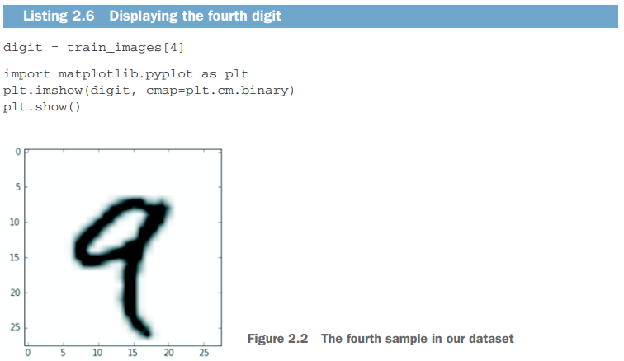

Slide 17
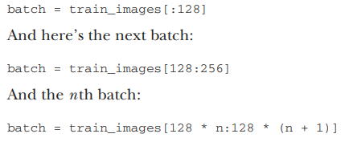
Batches
Deep-learning models don’t process an entire dataset at once; rather, they break the data into small batches

Slide 18
Real world examples
Vector data—2D tensors of shape (samples, features)
Timeseries data or sequence data—3D tensors of shape (samples, timesteps, features)
Images—4D tensors of shape (samples, height, width, channels) or (samples, channels, height, width)
Video—5D tensors of shape (samples, frames, height, width, channels) or (samples, frames, channels, height, width)

Slide 19
Vector data
This is the most common case. In such a dataset, each single data point can be encoded as a vector, and thus a batch of data will be encoded as a 2D tensor
The first axis is the samples axis and the second axis is the features axis

Slide 20
An actuarial dataset of people, where we consider each person’s age, ZIP code, and income. Each person can be characterized as a vector of 3 values, and thus an entire dataset of 100,000 people can be stored in a 2D tensor of shape (100000, 3).

Slide 21
A dataset of text documents, where we represent each document by the counts of how many times each word appears in it (out of a dictionary of 20,000 common words). Each document can be encoded as a vector of 20,000 values (one count per word in the dictionary), and thus an entire dataset of 500 documents can be stored in a tensor of shape (500, 20000).

Slide 22
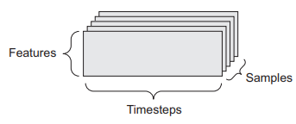
Timeseries data or sequence data
Whenever time matters in your data (or the notion of sequence order), it makes sense to store it in a 3D tensor with an explicit time axis.
Each sample can be encoded as a sequence of vectors (a 2D tensor), and thus a batch of data will be encoded as a 3D tensor

Slide 23
A dataset of stock prices. Every minute, we store the current price of the stock, the highest price in the past minute, and the lowest price in the past minute. Thus every minute is encoded as a 3D vector, an entire day of trading is encoded as a 2D tensor of shape (390, 3) (there are 390 minutes in a trading day), and 250 days’ worth of data can be stored in a 3D tensor of shape (250, 390, 3). Here, each sample would be one day’s worth of data.

Slide 24
A dataset of tweets, where we encode each tweet as a sequence of 280 characters out of an alphabet of 128 unique characters. In this setting, each character can be encoded as a binary vector of size 128 (an all-zeros vector except for a 1 entry at the index corresponding to the character). Then each tweet can be encoded as a 2D tensor of shape (280, 128), and a dataset of 1 million tweets can be stored in a tensor of shape (1000000, 280, 128).

Slide 25
Image data
Images typically have three dimensions: height, width, and color depth.
Although grayscale images (like our MNIST digits) have only a single color channel and could thus be stored in 2D tensors, by convention image tensors are always 3D, with a onedimensional color channel for grayscale images.
A batch of 128 grayscale images of size 256 × 256 could thus be stored in a tensor of shape (128, 256, 256, 1), and a batch of 128 color images could be stored in a tensor of shape (128, 256, 256, 3)

Slide 26
There are two conventions for shapes of images tensors: the channels-last convention (used by TensorFlow) and the channels-first convention (used by Theano).
The TensorFlow machine-learning framework, from Google, places the color-depth axis at the end: (samples, height, width, color_depth).
Meanwhile, Theano places the color depth axis right after the batch axis: (samples, color_depth, height, width)

Slide 27
Video data
Video data is one of the few types of real-world data for which you’ll need 5D tensors.
A video can be understood as a sequence of frames, each frame being a color image.
Because each frame can be stored in a 3D tensor (height, width, color_depth), a sequence of frames can be stored in a 4D tensor (frames, height, width, color_ depth), and thus a batch of different videos can be stored in a 5D tensor of shape (samples, frames, height, width, color_depth).

Slide 28
The gears of neural networks: tensor operations
All transformations learned by deep neural networks can be reduced to a handful of tensor operations applied to tensors of numeric data.
For instance, it’s possible to add tensors, multiply tensors, and so on.
A Keras layer instance looks like this:
keras.layers.Dense(512, activation='relu')

Slide 29
This layer can be interpreted as a function, which takes as input a 2D tensor and returns another 2D tensor—a new representation for the input tensor.
output = relu(dot(W, input) + b)
We have three tensor operations here: a dot product (dot) between the input tensor and a tensor named W; an addition (+) between the resulting 2D tensor and a vector b; and, finally, a relu operation. relu(x) is max(x, 0)

Slide 30
Element-wise operations
The relu operation and addition are element-wise operations: operations that are applied independently to each entry in the tensors being considered.
This means these operations are highly amenable to massively parallel implementations (vectorized implementations, a term that comes from the vector processor supercomputer architecture from the 1970–1990 period).

Slide 31
Basic Linear Algebra Subprograms (BLAS)
In practice, when dealing with Numpy arrays, these operations are available as well optimized built-in Numpy functions, which themselves delegate the heavy lifting to a Basic Linear Algebra Subprograms (BLAS) implementation if you have one installed (which you should).
BLAS are low-level, highly parallel, efficient tensor-manipulation routines that are typically implemented in Fortran or C.

Slide 32
So, in Numpy, you can do the following element-wise operation, and it will be blazing fast:
import numpy as np
z=x+y z = np.maximum(z, 0.)

Slide 33
Broadcasting
What happens with addition when the shapes of the two tensors being added differ?
When possible, and if there’s no ambiguity, the smaller tensor will be broadcasted to match the shape of the larger tensor.
Broadcasting consists of two steps:
Axes (called broadcast axes) are added to the smaller tensor to match the ndim of the larger tensor.
The smaller tensor is repeated alongside these new axes to match the full shape of the larger tensor

Slide 34
Tensor dot
The dot operation, also called a tensor product (not to be confused with an elementwise product) is the most common, most useful tensor operation.
Contrary to element-wise operations, it combines entries in the input tensors.
import numpy as np
z = np.dot(x, y)
You can also take the dot product between a matrix x and a vector y, which returns a vector where the coefficients are the dot products between y and the rows of x.

Slide 35
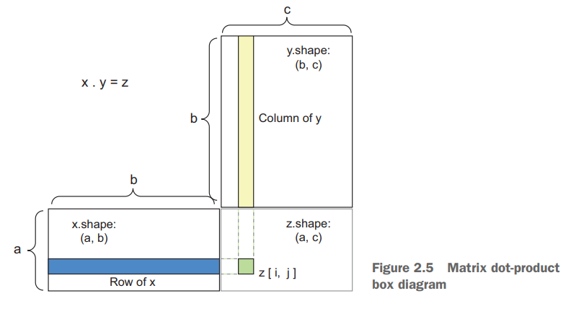

Slide 36
Tensor reshaping
A third type of tensor operation that’s essential to understand is tensor reshaping
Reshaping a tensor means rearranging its rows and columns to match a target shape.
Naturally, the reshaped tensor has the same total number of coefficients as the initial tensor.
A special case of reshaping that’s commonly encountered is transposition.
Transposing a matrix means exchanging its rows and its columns

Slide 37
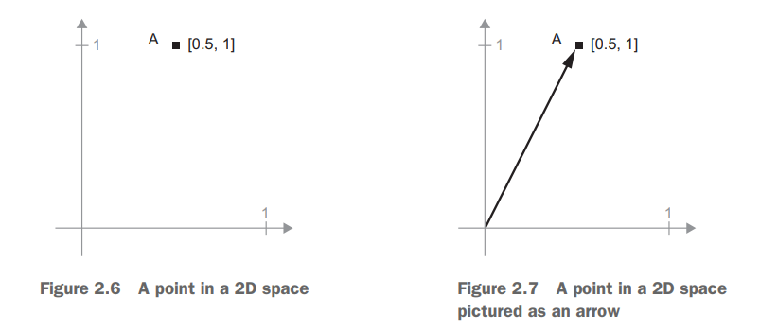
Geometric interpretation of tensor operations
A = [0.5, 1]

Slide 38
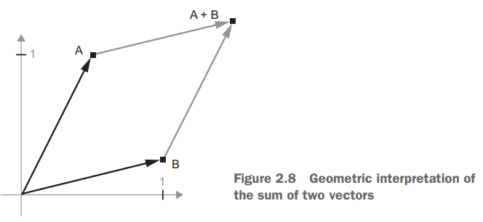
Let’s consider a new point, B = [1, 0.25], which we’ll add to the previous one

Slide 39
In general, elementary geometric operations such as affine transformations, rotations, scaling, and so on can be expressed as tensor operations.
For instance, a rotation of a 2D vector by an angle theta can be achieved via a dot product with a 2 × 2 matrix R = [u, v], where u and v are both vectors of the plane: u = [cos(theta), sin(theta)] and v = [-sin(theta), cos(theta)]

Slide 40
A geometric interpretation of deep learning
You just learned that neural networks consist entirely of chains of tensor operations and that all of these tensor operations are just geometric transformations of the input data.
It follows that you can interpret a neural network as a very complex geometric transformation in a high-dimensional space, implemented via a long series of simple steps.

Slide 41
Imagine two sheets of colored paper: one red and one blue. Put one on top of the other.
Now crumple them together into a small ball.
That crumpled paper ball is your input data, and each sheet of paper is a class of data in a classification problem.
What a neural network (or any other machine-learning model) is meant to do is figure out a transformation of the paper ball that would uncrumple it, so as to make the two classes cleanly separable again.
With deep learning, this would be implemented as a series of simple transformations of the 3D space, such as those you could apply on the paper ball with your fingers, one movement at a time.

Slide 42
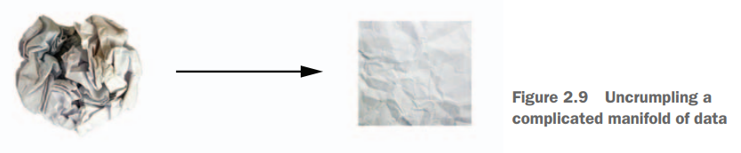

Slide 43
Uncrumpling paper balls is what machine learning is about: finding neat representations for complex, highly folded data manifolds.
At this point, you should have a pretty good intuition as to why deep learning excels at this: it takes the approach of incrementally decomposing a complicated geometric transformation into a long chain of elementary ones, which is pretty much the strategy a human would follow to uncrumple a paper ball.
Each layer in a deep network applies a transformation that disentangles the data a little—and a deep stack of layers makes tractable an extremely complicated disentanglement process.

Slide 44
The engine of neural networks: gradient-based optimization
output = relu(dot(W, input) + b)
In this expression, W and b are tensors that are attributes of the layer.
They’re called the weights or trainable parameters of the layer (the kernel and bias attributes, respectively).
Initially, these weight matrices are filled with small random values
What comes next is to gradually adjust these weights, based on a feedback signal.
This gradual adjustment, also called training, is basically the learning that machine learning is all about.

Slide 45
Training
Draw a batch of training samples x and corresponding targets y.
Run the network on x (a step called the forward pass) to obtain predictions y_pred.
Compute the loss of the network on the batch, a measure of the mismatch between y_pred and y.
Update all weights of the network in a way that slightly reduces the loss on this batch.

Slide 46
The difficult part is step 4: updating the network’s weights.
Given an individual weight coefficient in the network, how can you compute whether the coefficient should be increased or decreased, and by how much?
The approach is to take advantage of the fact that all operations used in the network are differentiable, and compute the gradient of the loss with regard to the network’s coefficients.
You can then move the coefficients in the opposite direction from the gradient, thus decreasing the loss.

Slide 47
What is a derivative?
Consider a continuous, smooth function f(x) = y, mapping a real number x to a new real number y.
Because the function is continuous, a small change in x can only result in a small change in y—that’s the intuition behind continuity
f(x + epsilon_x) = y + epsilon_y
f(x + epsilon_x) = y + a * epsilon_x
The slope a is called the derivative of f in p.
If a is negative, it means a small change of x around p will result in a decrease of f(x)
Further, the absolute value of a (the magnitude of the derivative) tells you how quickly this increase or decrease will happen.

Slide 48
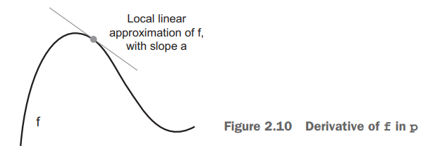

Slide 49
For every differentiable function f(x) there exists a derivative function f'(x) that maps values of x to the slope of the local linear approximation of f in those points
If you want to reduce the value of f(x), you just need to move x a little in the opposite direction from the derivative.

Slide 50
Derivative of a tensor operation: the gradient
A gradient is the derivative of a tensor operation.
loss_value = loss(y_pred, y)
You saw earlier that the derivative of a function f(x) of a single coefficient can be interpreted as the slope of the curve of f.
Likewise, gradient(f)(W0) can be interpreted as the tensor describing the curvature of f(W) around W0.

Slide 51
Stochastic gradient descent
Given a differentiable function, it’s theoretically possible to find its minimum analytically: it’s known that a function’s minimum is a point where the derivative is 0, so all you have to do is find all the points where the derivative goes to 0 and check for which of these points the function has the lowest value.
Applied to a neural network, that means finding analytically the combination of weight values that yields the smallest possible loss function.
This can be done by solving the equation gradient(f)(W) = 0 for W.

Slide 52
This is a polynomial equation of N variables, where N is the number of coefficients in the network.
Although it would be possible to solve such an equation for N = 2 or N = 3, doing so is intractable for real neural networks, where the number of parameters is never less than a few thousand and can often be several tens of millions.

Slide 53
Instead, you can use the four-step algorithm outlined at the beginning of this section: modify the parameters little by little based on the current loss value on a random batch of data.
Because you’re dealing with a differentiable function, you can compute its gradient, which gives you an efficient way to implement step 4

Slide 54
Mini-batch stochastic gradient descent
Draw a batch of training samples x and corresponding targets y.
Run the network on x to obtain predictions y_pred.
Compute the loss of the network on the batch, a measure of the mismatch between y_pred and y.
Compute the gradient of the loss with regard to the network’s parameters (a backward pass).
Move the parameters a little in the opposite direction from the gradient—for example W -= step * gradient—thus reducing the loss on the batch a bit.

Slide 55
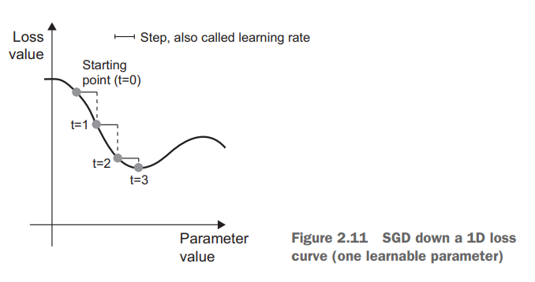

Slide 56
Learning rate
As you can see, intuitively it’s important to pick a reasonable value for the step factor.
If it’s too small, the descent down the curve will take many iterations, and it could get stuck in a local minimum.
If step is too large, your updates may end up taking you to completely random locations on the curve.

Slide 57
Batch Vs True Stochastic
Note that a variant of the mini-batch SGD algorithm would be to draw a single sample and target at each iteration, rather than drawing a batch of data.
This would be true SGD
Alternatively, going to the opposite extreme, you could run every step on all data available, which is called batch SGD

Slide 58
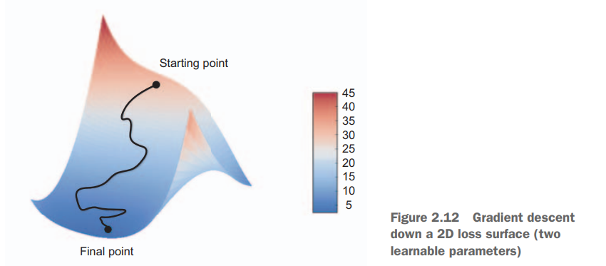

Slide 59
Variants of Gradient Descent
There exist multiple variants of SGD that differ by taking into account previous weight updates when computing the next weight update, rather than just looking at the current value of the gradients.
There is, for instance, SGD with momentum, as well as Adagrad, RMSProp, and several others.
Such variants are known as optimization methods or optimizers.
In particular, the concept of momentum, which is used in many of these variants, deserves your attention.
Momentum addresses two issues with SGD: convergence speed and local minima

Slide 60
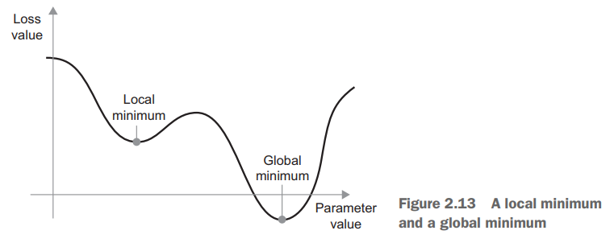

Slide 61
A useful mental image here is to think of the optimization process as a small ball rolling down the loss curve.
If it has enough momentum, the ball won’t get stuck in a ravine and will end up at the global minimum.
Momentum is implemented by moving the ball at each step based not only on the current slope value (current acceleration) but also on the current velocity (resulting from past acceleration)

Slide 62
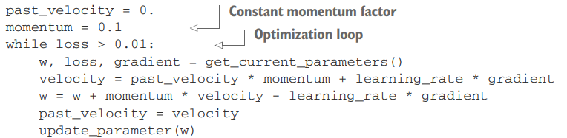
In practice, this means updating the parameter w based not only on the current gradient value but also on the previous parameter update, such as in this naive implementation:

Slide 63
Chaining derivatives: the Backpropagation algorithm
In practice, a neural network function consists of many tensor operations chained together, each of which has a simple, known derivative.
For instance, this is a network f composed of three tensor operations, a, b, and c, with weight matrices W1, W2, and W3:
f(W1, W2, W3) = a(W1, b(W2, c(W3)))
Calculus tells us that such a chain of functions can be derived using the following identity, called the chain rule: f(g(x)) = f'(g(x)) * g'(x).

Slide 64
Applying the chain rule to the computation of the gradient values of a neural network gives rise to an algorithm called Backpropagation (also sometimes called reverse-mode differentiation)
Backpropagation starts with the final loss value and works backward from the top layers to the bottom layers, applying the chain rule to compute the contribution that each parameter had in the loss value.

Slide 65
Nowadays, and for years to come, people will implement networks in modern frameworks that are capable of symbolic differentiation, such as TensorFlow.
This means that, given a chain of operations with a known derivative, they can compute a gradient function for the chain (by applying the chain rule) that maps network parameter values to gradient values.
When you have access to such a function, the backward pass is reduced to a call to this gradient function.
Thanks to symbolic differentiation, you’ll never have to implement the Backpropagation algorithm by hand.

